Slide 1
Insurance Cost Prediction

Slide 2
Problem Statement
What factors contributed to insurance cost?
Bmi, age, smoker?

Slide 3
The Solution
Insurance cost tend to be lower for people who has healthy lifestyle
Non-smoker, not overweight, young.

Slide 4
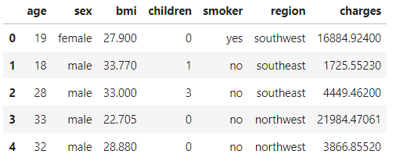
Data
Source: https://www.kaggle.com/code/mariapushkareva/medical-insurance-cost-with-linear-regression
This dataset contain the below information:
Age, sex, bmi, children, smoker, and region

Slide 5
Data Cleaning
There is 1 duplicated row
Added 1 additional feature (bmi_cat)
This feature specify bmi_cat
Under weight
Normal weight
Over weight
Obese
Severely Obese
Morbidly Obese

Slide 6
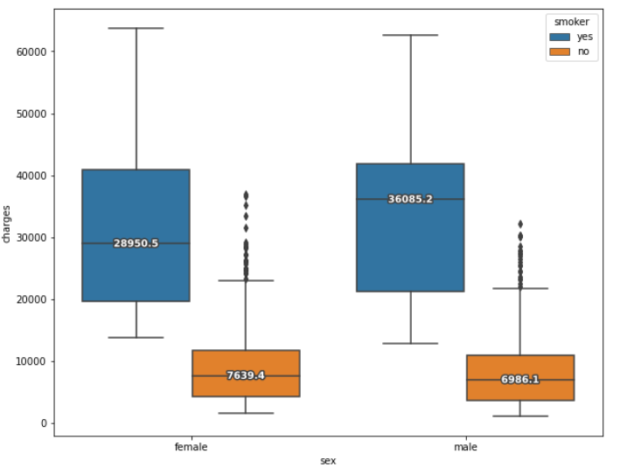
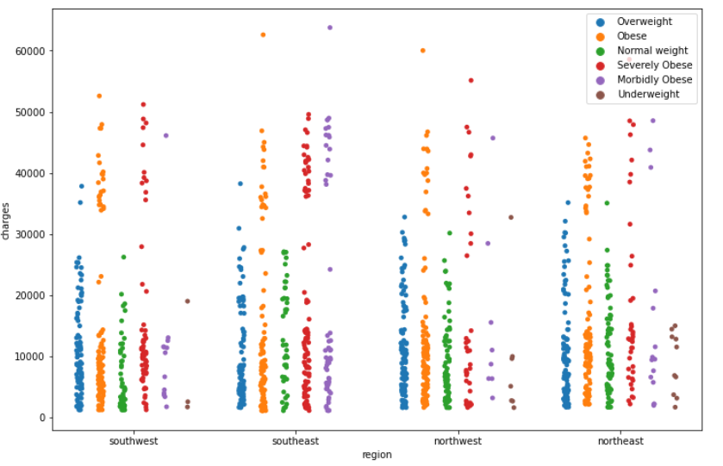
Data Summary
Smoker tends to have higher insurance cost regardless of male or female
Region do not have much contribution to insurance cost

Slide 7
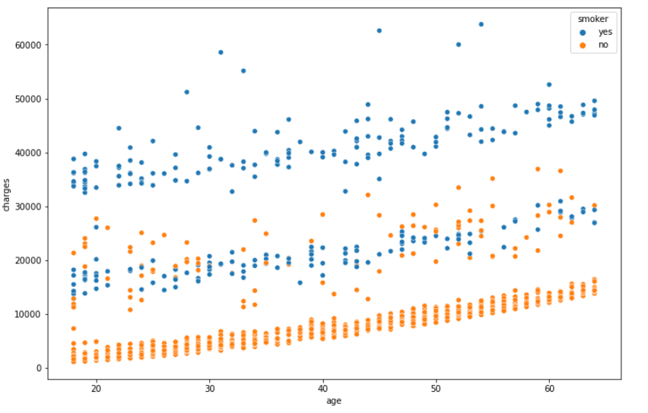
Data Summary Continue
Medical charges increase with age
From the graph:
The first cluster are non-smoker
The second cluter are a mix of smoker and non-smoker with other medical issue
The final cluster are smokers with major medical issues

Slide 8
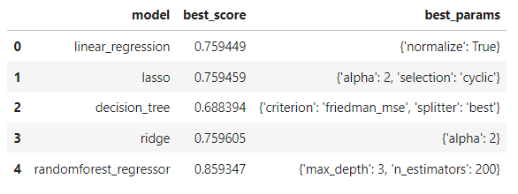
Model
5 different models were used
Random forest giving the best accuracy result

Slide 9
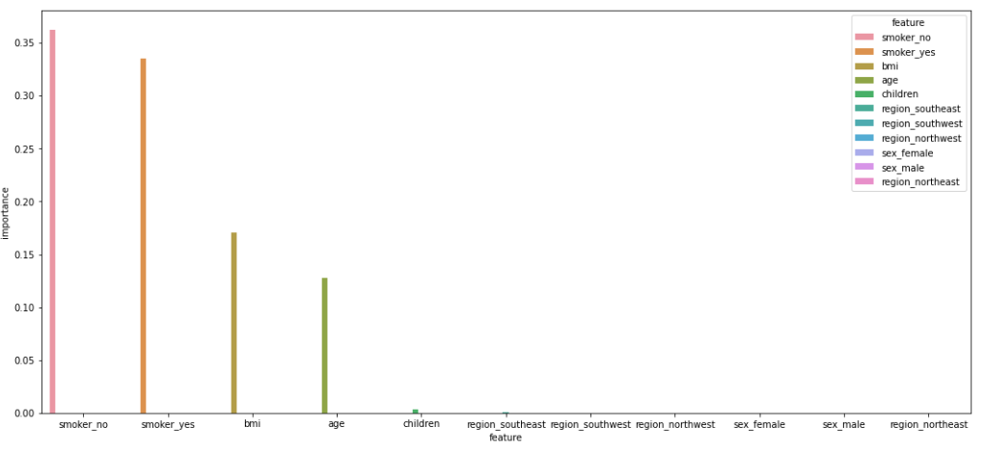
Features of importance

Slide 10
Future Study
Add more features to the dataset
Major medical issue?
Went through surgery?
Family background?

Slide 11
Conclusion
Based on model, our prediction is off by $4804.06 from actual insurance cost
Approximately 84.24% of the variation in the charges can correlate to the features in our data

